Slide 1
REM SLEEP STAGE IDENTIFICATION WITH WAVELET DECOMPOSITION AND ARTIFICIAL NEURAL NETWORK USING A SINGLE CHANNEL EEG
Gabriel Toban

Slide 2
Why Use Sleep Stages?
Separate Wakefulness from Sleep state
Identify physiologic and pathologic events
Paralysis in REM
Arousals and pathology (Apnea)
K-complexes and pathology (Epilepsy)
Required for some sleep studies with EEG

Slide 3
What is an EEG?
Electroencephalogram
Difference in electric potentials
Produces “brain waves”

Slide 4
How to Identify Sleep Stages?
American Academy of Sleep Medicine
Polysomnogram or Polysomnographic Record (PSG) and Epochs
Home Study

Slide 5
What is a PSG?
Sleep study
Collection of parameters
Includes
EEG Electroencephalogram (brain)
EOG Electrooculogram (eyes)
EMG Electromyogram (muscles)

Slide 6
What is a Home Study?
Typically for sleep apnea
(HSAT) Home Sleep Apnea Testing
Sleep staging required for some
Much fewer parameters and equipment

Slide 7
Automated Sleep Staging
Manual Sleep Staging Requires Tech
Scoring Guides from AASM
Some use many parameters
Some use very few parameters

Slide 8
Presentation Outline
Background
The Single Channel EEG
Signal Processing
Classification
Methods and Results
Conclusion and Future

Slide 9
Background
The Single Channel EEG
Signal Processing
Classification
Methods and Results
Conclusion and Future

Slide 10
The EEG
Electrodes on the head
Two Electrodes make a channel
The 10/20 System
The R&K Standard
The AASM
Brain Waves, Activities, and Events (Markers)
Amplitude, Frequency, and Other Factors

Slide 11
5 EEG Frequencies
Name | Frequency (Hz) | Peak-to-Peak Amplitude (uV)
Slow Wave Activity | 0.5-2.0 | >75
Delta Waves | 0-3.99 | N/A
Theta Waves | 4-7.99 | N/A
Alpha Waves | 8-13 | N/A
Beta Waves | >13 | N/A

Slide 12
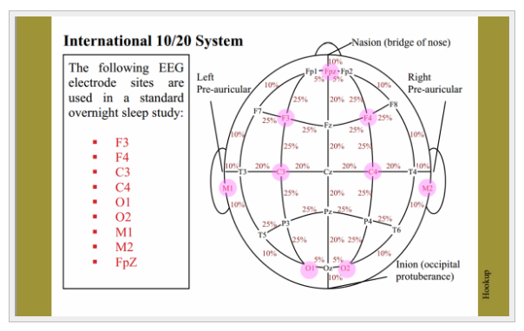
The 10/20 System

Slide 13
Brain Lobes/Regions
Abbreviation | Region
Fp | Frontal pole
F | Frontal
T | Temporal
C | Central
P | Parietal
O | Occipital
M | Mastoid

Slide 14
EEG Channels
Recommended | Acceptable
F4-M1 | Fz-Cz
C3-M1 | Cz-Oz
O2-M1 | C4-M1

Slide 15
Markers to Lobes/Channels
 | Slow Wave | V-Waves | K-complexes | Spindles | Sawtooth | Alpha
Frontal |  |  | Maximal
Central |  | Maximal |  | Maximal | Maximal | Adequate
Occipital |  |  |  |  |  | Maximal
Fz-Cz | No
E1-Fpz | Yes
E1-Fpz (the frontal regions referenced to the contralateral ear or mastoid )

Slide 16
Sleep Stages
R&K | AASM
Wakefulness (W) | Wakefulness (W)
Movement Time (MT)
Stage 1 | NREM 1 (N1)
Stage 2 | NREM 2 (N2)
Stage 3 | NREM 3 (N3)
Stage 4
NREM (1,2,3,4)
REM (R) | REM (R)

Slide 17
Stages to Markers
 | W | N1 | N2 | N3 | REM
Slow Wave |  |  |  | R
V-Waves |  | NR
K-complexes |  | P | R |  | P
Spindles |  | P | R |  | P
Sawtooth |  |  |  |  | NR
Alpha | NR | P |  |  | P
Beta | NR
LAMF (theta) |  | R | P |  | R
Theta |  | P
No Arousal |  |  | P |  | P
NR: Not Required; R: Required; P: Possible; Blank: Not mentioned or not possible

Slide 18
Epochs
Too small too cumbersome
Too large; miss details
Paper sizes are fit 30 seconds

Slide 19
This Study
A Single Channel
Channel Fpz-Cz
30 Second Epochs
REM Sleep Stage

Slide 20
Background
The Single Channel EEG
Signal Processing
Classification
Methods and Results
Conclusion and Future

Slide 21
Signal Processing
A brainwave is a signal
Fourier Series
EEG Waves
Time-Frequency Signal Analysis
Wavelets

Slide 22
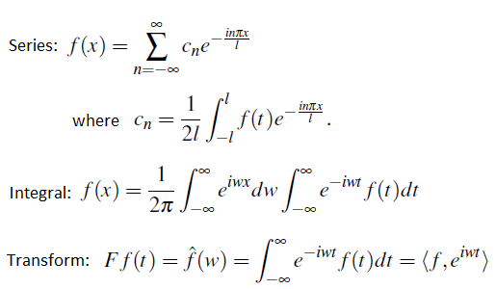
Fourier

Slide 23
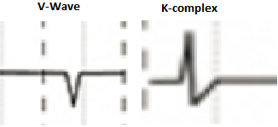
EEG Waves

Slide 24
Time-Frequency Analysis
Short-Time Fourier Transform
Wavelet Transform
Choi-Williams Distribution
Wigner-Ville Distributions

Slide 25
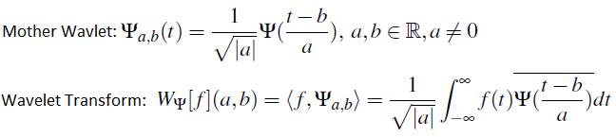
Wavelet Transforms

Slide 26
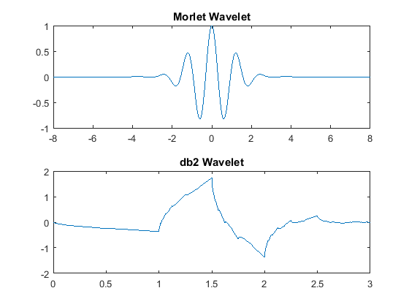
Mother Wavelets

Slide 27
Wavelet Transform Modifications
Continuous Wavelet Transform
Discrete Wavelet Transform
Multilevel Discrete Wavelet
Wavelet Packet Tree
Many More

Slide 28
This Study
Multilevel Discrete Wavelet Transform with Daubechies Order 2 Mother Wavelet

Slide 29
Background
The Single Channel EEG
Signal Processing
Classifcation
Methods and Results
Conclusion and Future

Slide 30
Classification
Classification Algorithms
Artificial Neural Networks (ANNs)

Slide 31
Classification Algorithms
Support Vector Machine
Hidden Markov Model
ANN

Slide 32
Artificial Neural Networks
Feedforward Backward Propagation
Deep Feedforward Networks
Deep Belief Networks
Multilayer Perceptrons

Slide 33
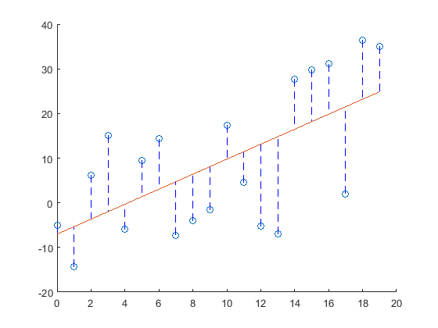
Linear Regression

Slide 34

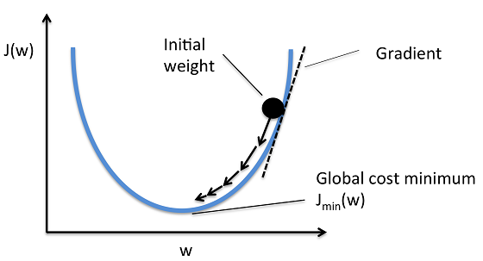
Gradient Descent

Slide 35

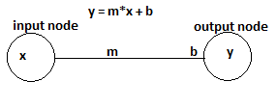
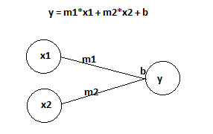
Linear Regression Nodes

Slide 36
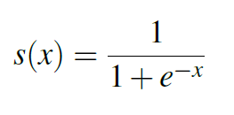
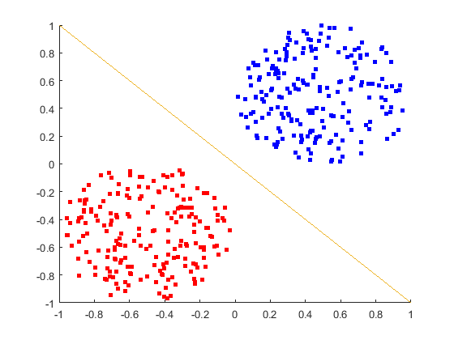
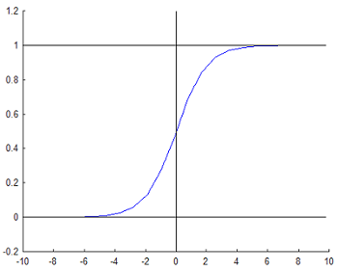
Sigmoid Function
Linear Decision Boundary

Slide 37

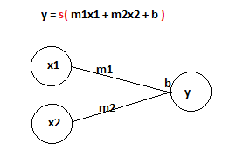
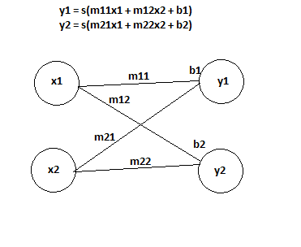
Logistic Regression Nodes

Slide 38
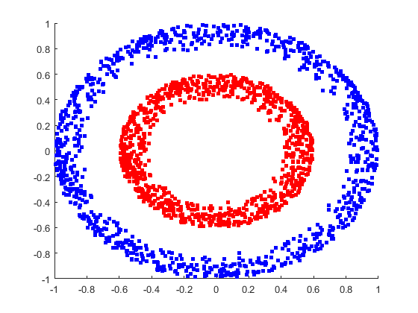
Non-linear Decision Boundary

Slide 39
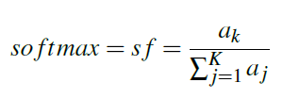

SoftMax

Slide 40

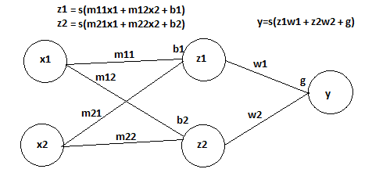
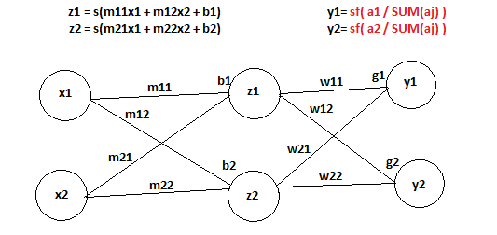
Artificial Neural Network

Slide 41
Background
The Single Channel EEG
Signal Processing
Classification
Methods and Results
Conclusion and Future

Slide 42
Methods
Dataset
EDFbrowser
epochs.py
softANN.py

Slide 43
Dataset
”The Sleep-EDF Database [Expanded]” from physionet.org
10 males and 10 females
25-34 years old
2 nights of recordings per person
24 nights sued
The PSG recording included an EEG from Fpz-Cz and Pz-Oz electrode locations, anEOG (horizontal), a submental chin EMG, an event marker, an oral-nasal respiration, andrectal body temperature.
annotationsincluded W for wakefulness, R for REM, stage 1, stage 2, stage 3, stage 4, M for movement time and ? for not scored

Slide 44
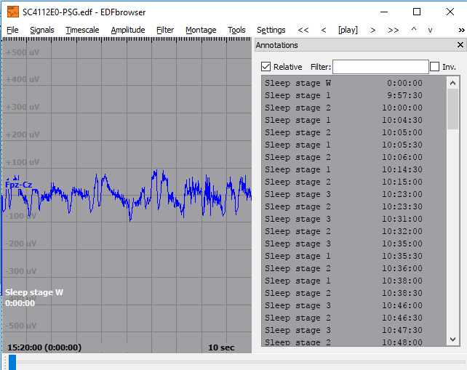
EDFbrowser

Slide 45

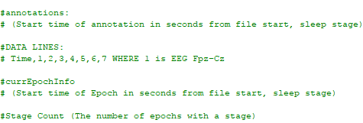
Epochs.py

Slide 46

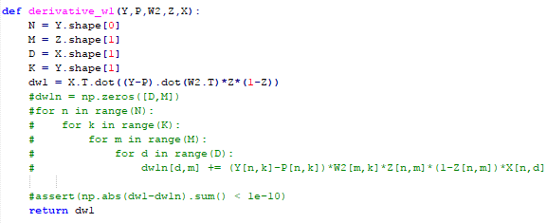
softAnn.py

Slide 47
Results: Train
ID | DATA | Learning Rate | Result | Final Cost | STOP
3.15000 | Patient 001 + 031 + 101 + 161 | 10e-5 | Complete | -4.45 | Accuracy = 100
3.3000 | Patient 001 | 10e-5 | Complete | -16 | Accuracy = 100
3.36000 | Patient 001 | 10e-5 | Complete | -0.99 | Cost < 10e-1
3.6000 | Patient 001 ->101 | 10e-5 | Complete | -26.9 | Accuracy = 100
3.85000 | Patient 001 + 101 | 10e-5 | Complete | -16.16 | Accuracy = 100
2.5500 | Patient 001 + 101 | 10e-5 | Complete | -6.07 | Accuracy = 100
2.?1 | Paitent 001+031+101+161 | 10e-5 | OVERFLOW |  | Accuracy = 100
2.?2 | Paitent 001+031+101+161 | 10e-7 | Stopped |  | Accuracy = 100

Slide 48
Results: Predict
ID | Accuracy | Sensitivity | Specificity
3.15000 | 89.98% | 38.07% | 96.38%
3.3000 | 79.67% | 36.01% | 89.82%
3.36000 | 84.40% | 29.89% | 91.83%
3.6000 | 85.82% | 17.54% | 93.30%
3.85000 | 81.12% | 42.79% | 88.20%
2.5500 | 83.49% | 39.14% | 88.63%
AVG | 84.08% | 33.91% | 91.36%

Slide 49
Background
The Single Channel EEG
Signal Processing
Classifcation
Methods and Results
Conclusion and Future

Slide 50
Conclusion
Untested Factors
Categorizing REM is not possible yet
Testing more nights
Categorizing Not REM is possible

Slide 51
Future
EEG Channel
Sleep Stage
Epoch length
Wavelet Transforms
Neural Networks

Slide 52
References
[1]“10/20 system | Polysomnography Study Guide.” .
[2]10/20 System Positioning Manual. Trans Cranial Technologies.
[3]R. B. Berry, MD (Chair) et al., AASM Manual for the Scoring of Sleep and Associated Events: Rules, Terminology and Technical Specifications, vol. 2.4. American Academy of Sleep Medicine.
[4] van S. B, K. B, K. Ha, and V. der V. Ea, “Alternative electrode placement in (automatic) sleep scoring (Fpz-Cz/Pz-Oz versus C4-A1).,” Sleep, vol. 13, no. 3, pp. 279–283, Jun. 1990.
[5]A. Rechtschaffen and A. Kales, A manual of Standardized Terminology, Techniques and Scoring System for Sleep Stages of Human Subjects. .
[6]E. A. Wolpert, “A Manual of Standardized Terminology, Techniques and Scoring System for Sleep Stages of Human Subjects.,” Archives of General Psychiatry, vol. 20, no. 2, p. 246, Feb. 1969.
[7]F. Lotte, M. Congedo, A. Lécuyer, F. Lamarche, and B. Arnaldi, “A review of classification algorithms for EEG-based brain–computer interfaces,” J. Neural Eng., vol. 4, no. 2, p. R1, 2007.
[8]J. Heaton, Artificial Intelligence for Humans Volume 3: Deep Learning and Neural Networks. 2015.
[9]R. K. Sinha, “Artificial Neural Network and Wavelet Based Automated Detection of Sleep Spindles, REM Sleep and Wake States,” J Med Syst, vol. 32, no. 4, pp. 291–299, Aug. 2008.
[10]L. Fraiwan, K. Lweesy, N. Khasawneh, H. Wenz, and H. Dickhaus, “Automated sleep stage identification system based on time–frequency analysis of a single EEG channel and random forest classifier,” Computer Methods and Programs in Biomedicine, vol. 108, no. 1, pp. 10–19, Oct. 2012.
[11]F. Ebrahimi, M. Mikaeili, E. Estrada, and H. Nazeran, “Automatic sleep stage classification based on EEG signals by using neural networks and wavelet packet coefficients,” in 2008 30th Annual International Conference of the IEEE Engineering in Medicine and Biology Society, 2008, pp. 1151–1154.
[12]L. Parrino, R. Ferri, O. Bruni, and M. G. Terzano, “Cyclic alternating pattern (CAP): The marker of sleep instability,” Sleep Medicine Reviews, vol. 16, no. 1, pp. 27–45, Feb. 2012.
[13]LazyProgrammer.me, “Data Science: Deep Learning in Python.”
[14]LazyProgrammer.me, “Data Science: Linear Regression in Python.”
[15]LazyProgrammer.me, “Data Science: Logistic Regression in Python.”
[16]T. Rao and D. D. Vishwanath, “Detecting sleep disorders based on EEG signals by using discrete wavelet transform,” in Green Computing Communication and Electrical Engineering (ICGCCEE), 2014 International Conference on, 2014, pp. 1–5.
[17]D. Sundararajan, Discrete Wavelet Transform: A Signal Processing Approach. John Wiley & Sons, 2016.
[18]P. Achermann, “EEG analysis applied to sleep,” Epileptologie, vol. 26, pp. 28–33, 2009.
[19]“European Data Format (EDF).” [Online]. Available: http://www.edfplus.info/. [Accessed: 19-Jun-2017].
[20]G. Dietsch, “Fourier-Analyse von Elektrencephalogrammen des Menschen,” Pflügers Arch., vol. 230, no. 1, pp. 106–112, Dec. 1932.

Slide 53
References
[21]F. Hlawatsch and G. F. Boudreaux-Bartels, “Linear and quadratic time-frequency signal representations,” IEEE Signal Processing Magazine, vol. 9, no. 2, pp. 21–67, Apr. 1992.
[22]“Machine Learning FAQ,” Sebastian Raschka’s Website. [Online]. Available: sebastianraschka.com/faq/docs/closed-form-vs-gd. [Accessed: 10-Aug-2017].
[23]“MethodsEEGMeasurement.pdf.” .
[24]A. Baratloo, M. Hosseini, A. Negida, and G. El Ashal, “Part 1: Simple Definition and Calculation of Accuracy, Sensitivity and Specificity,” Emerg (Tehran), vol. 3, no. 2, pp. 48–49, 2015.
[25]C. L. Byrne, Signal Processing, 2nd Edition, 2nd ed. CRC Press, 2014.
[26]E. M. Ventouras et al., “Sleep spindle detection using artificial neural networks trained with filtered time-domain EEG: A feasibility study,” Computer Methods and Programs in Biomedicine, vol. 78, no. 3, pp. 191–207, Jun. 2005.
[27]“Spectral density,” Wikipedia. 31-Jul-2017.
[28]M. B. Kurt, N. Sezgin, M. Akin, G. Kirbas, and M. Bayram, “The ANN-based computing of drowsy level,” Expert Systems with Applications, vol. 36, no. 2, pp. 2534–2542, Mar. 2009.
[29]S. F. Quan et al., “The association between obstructive sleep apnea and neurocognitive performance—the Apnea Positive Pressure Long-term Efficacy Study (APPLES),” Sleep, vol. 34, no. 3, p. 303–314B, 2011.
[30]“The CAP Sleep Database.” [Online]. Available: https://physionet.org/pn6/capslpdb/. [Accessed: 24-May-2017].
[31]M. G. Terzano, D. Mancia, M. R. Salati, G. Costani, A. Decembrino, and L. Parrino, “The Cyclic Alternating Pattern as a Physiologic Component of Normal NREM Sleep,” Sleep, vol. 8, no. 2, pp. 137–145, Jun. 1985.
[32]P. S. Addison, The Illustrated Wavelet Transform Handbook: Introductory Theory and Applications in Science, Engineering, Medicine and Finance, Second Edition. CRC Press, 2017.
[33]“The Sleep-EDF Database [Expanded].” [Online]. Available: https://www.physionet.org/physiobank/database/sleep-edfx/. [Accessed: 24-May-2017].
[34]“Time-frequency Signal Analysis with Applications.” [Online]. Available: http://eds.b.ebscohost.com.ezproxy.mtsu.edu/eds/ebookviewer/ebook/bmxlYmtfXzc1MzU4OF9fQU41?sid=8234de8b-f2a6-417d-93de-597fe37750c7@sessionmgr102&vid=6&format=EB&rid=8. [Accessed: 21-Jun-2017].
[35]D. Álvarez et al., “Usefulness of Artificial Neural Networks in the Diagnosis and Treatment of Sleep Apnea-Hypopnea Syndrome,” 2017.
[36]J. R. Shambroom, S. E. Fábregas, and J. Johnstone, “Validation of an automated wireless system to monitor sleep in healthy adults,” Journal of Sleep Research, vol. 21, no. 2, pp. 221–230, Apr. 2012.
[37]N. Crasto and R. Upadhyay, “Wavelet Decomposition Based Automatic Sleep Stage Classification Using EEG,” in Bioinformatics and Biomedical Engineering, 2017, pp. 508–516.
[38]L. Debnath and F. Shah, Wavelet Transforms and Their Applications. Springer, 2014.

